Slide 1





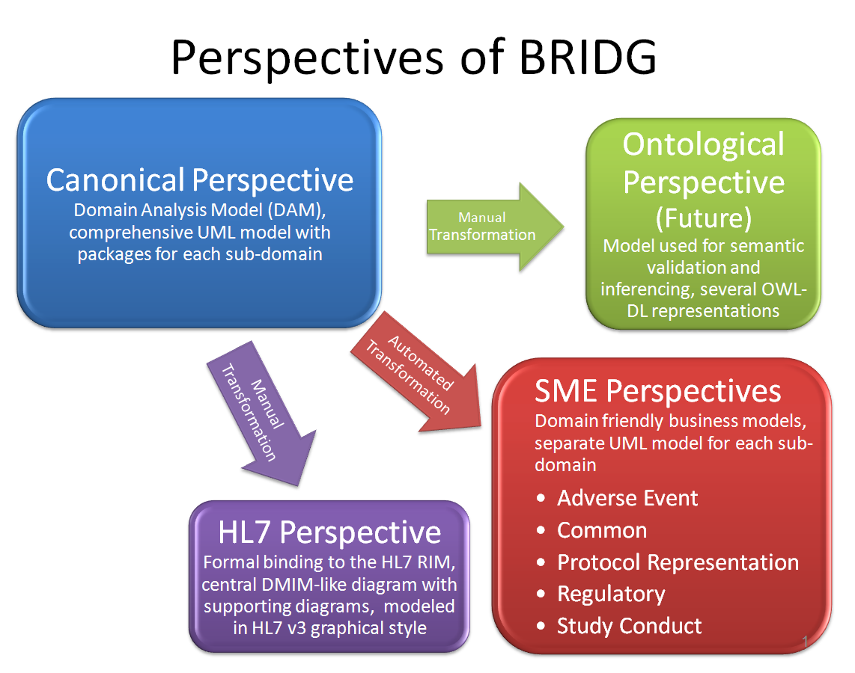

BRIDG Update
Project Description/Scope
Accomplishments
BRIDG is a collaborative effort to produce a shared view of the dynamic and static semantics that collectively define a shared domain-of-interest.
Scope: Protocol-driven research and its associated regulatory artifacts, i.e. the data, organization, resources, rules, and processes involved in the formal assessment of the utility, impact, or other pharmacological, physiological, or psychological effects of a drug, procedure, process, subject characteristic, biologic, cosmetic, food or device on a human, animal, or other subject or substance plus all associated regulatory artifacts required for or derived from this effort, including data specifically associated with post-marketing adverse event reporting.
BRIDG Stakeholders:
BRIDG = Biomedical Research Integrated Domain Group
BRIDG Overall
  Publication of BRIDG R3.0.3 in December 2010 – new content includes SDTM V3.1.2, CDASH V1.1, FDA HL7 ICSR.
  Publication of BRIDG Harmonization Package – detailed instructions on how to harmonize with BRIDG
CDISC BRIDG Activities
  Statistics Domain Analysis Model - scheduled for harmonization Oct 2011
  SDTM/CDASH/TDM BRIDG Harmonization
      Mapping of all SDTM and CDASH variables to BRIDG R3.0.3
      Changes to BRIDG based on SDTM and CDASH semantics
  SDM-XML Beginning to map to BRIDG
Goals
Next Steps
The goal of the BRIDG Project is to produce a shared view of the dynamic and static semantics of a protocol-driven research and its associated regulatory artifacts.
This shared view enables:
  Achievement of computable semantic interoperability (CSI), i.e. the ability for information systems to exchange at a machine-to-machine level the meaning (rather than simply the structure) of data, which allows for aggregation of study data without mapping and other important benefits.
BRIDG Overall
  Next release at end of 2011
  Current harmonizations include: NCI’s Hematopoietic Cell Transplantation (HCT) project; NCI’s Case Report Form project, Genzyme’s RegistryNXT!; CTSA Human Studies Database; FDA’s HL7 Study Participation message
  Next round of ISO Balloting in progress
CDISC BRIDG Activities
  SHARE – The SHARE project uses BRIDG as its foundational information model
  Statistics Domain Analysis Model – complete DAM and harmonize with BRIDG – late 2011
Additional Information
Team Members
CDISC BRIDG Teams:
  Statistics Domain Analysis Model: Cathy Barrows (GSK), Greg Anglin (Lilly), Jack Shostak (DCRI), Michael Nessly (Shire), Susan Kenny (Inspire), AbdulMalik Shakir (Shakir Consulting), Julie Evans (CDISC)
  SDTM/CDASH/TDM BRIDG Harmonization: Diane Wold (GSK), Fred Wood (Octagon), Rhonda Facile (Lockheed Martin), AbdulMalik Shakir (Shakir Consulting), Shannon Labout (CDISC), Melissa Cook (Octagon), Jay Leeka (AstraZeneca), Charlene Dark (i3 Statprobe), Julie Evans (CDISC)
BRIDG Semantic Coordination Committee: Steve Sandberg (ScenPro/NCI), Becky Angeles (ScenPro/NCI), Lloyd McKenzie (GPI/NCI), Wendy VerHoef (ScenPro/NCI), Smita Hastak (ScenPro/NCI), Charlie Mead (NCI), Julie Evans (CDISC)
BRIDG Board of Directors: Chuck Jaffe (HL7), Jack Jones (NIH); Bron
Kisler (CDISC); Becky Kush (CDISC)*, Jonathan Levine (FDA); Cecil Lynch (OntoReason), Charlie Mead (NCI), Mitra Rocca (FDA), AbdulMalik Shakir (Shakir Consulting), John Speakman (NCI) * Chair
As a catalyst for productive collaboration, CDISC brings together
individuals spanning the healthcare continuum to develop
global, open, consensus-based medical research data standards.

